Slide 1

Springboard Second Project – Machine Learning
Bo Zhang

Slide 2
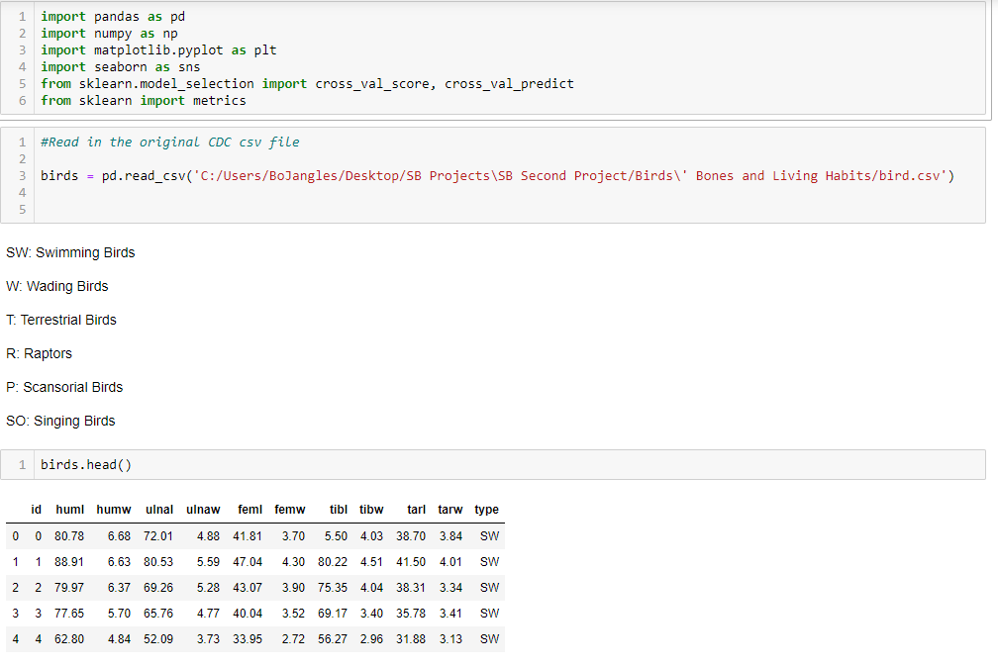
Importing the data

Slide 3
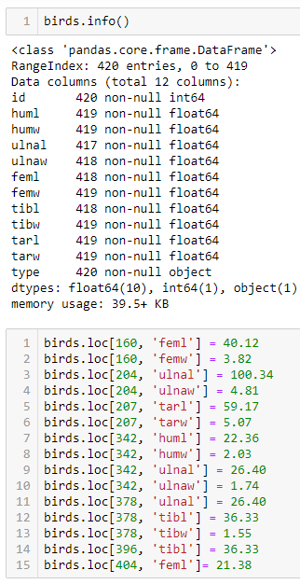
Understanding and Cleaning the Data

Slide 4
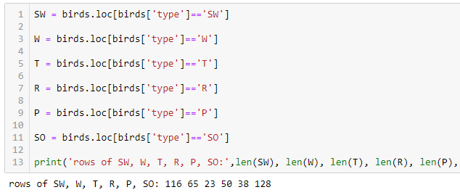
Understanding and Cleaning the Data

Slide 5
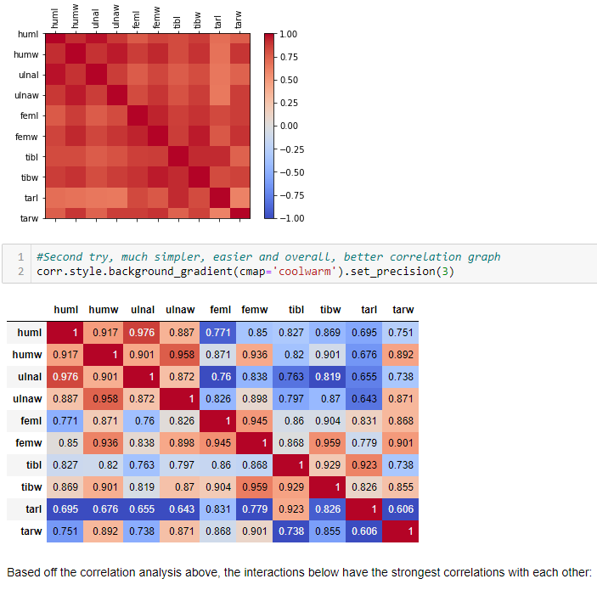
Correlation Analysis

Slide 6
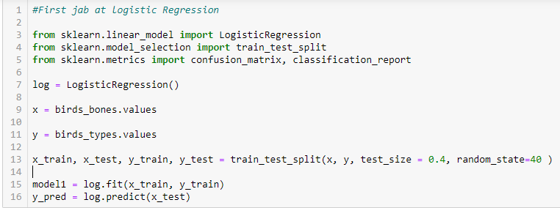
First Logistic Regression

Slide 7
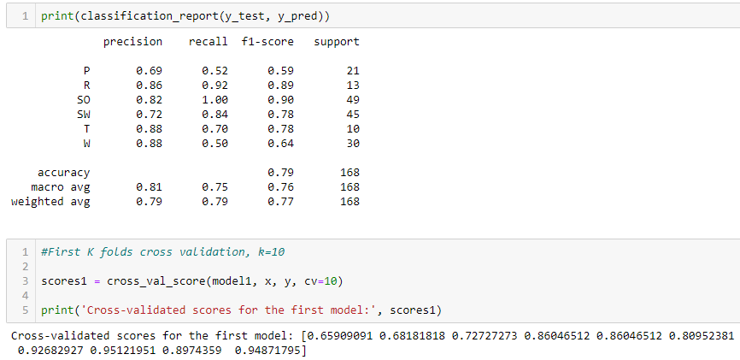
First Logistic Regression - Results

Slide 8
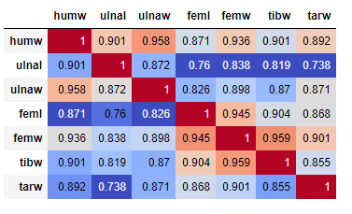
Second correlation analysis after eliminating some bone types

Slide 9
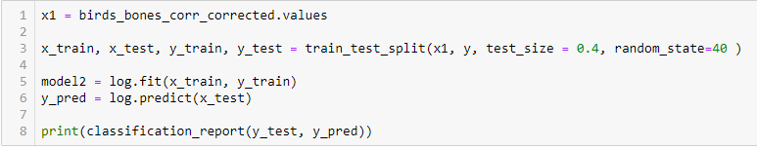
Second Logistic Regression

Slide 10
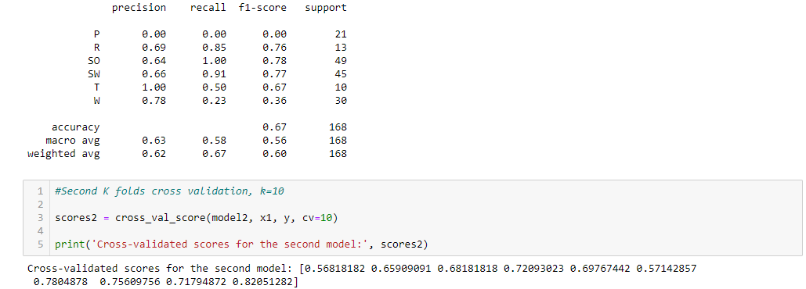
Second Logistic Regression - Results

Slide 11
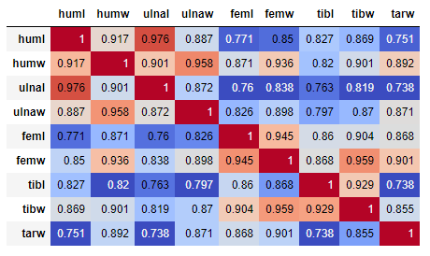
Third correlation analysis after removing only “tarl” bone type

Slide 12
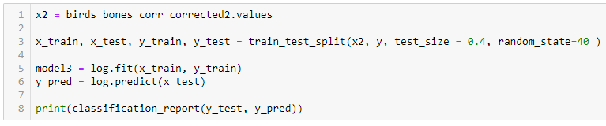
Third logistic regression

Slide 13
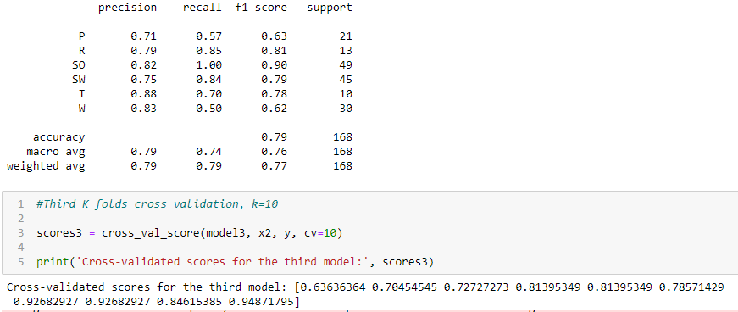
Third logistic regression - results

Slide 14
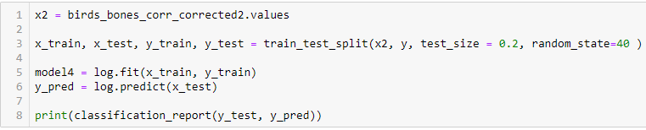
Fourth logistic regression

Slide 15
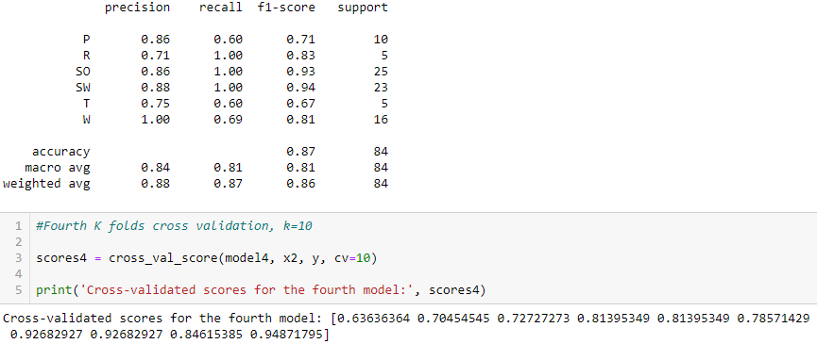
Fourth logistic regression - results

Slide 16
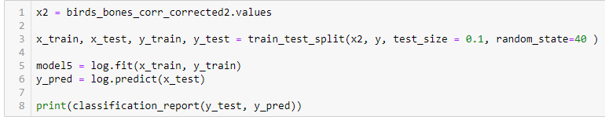
Fifth logistic regression

Slide 17
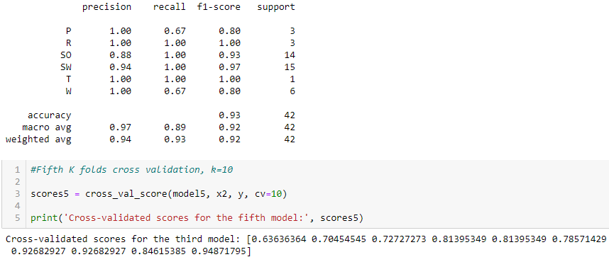
Fifth logistic regression - results

Slide 18
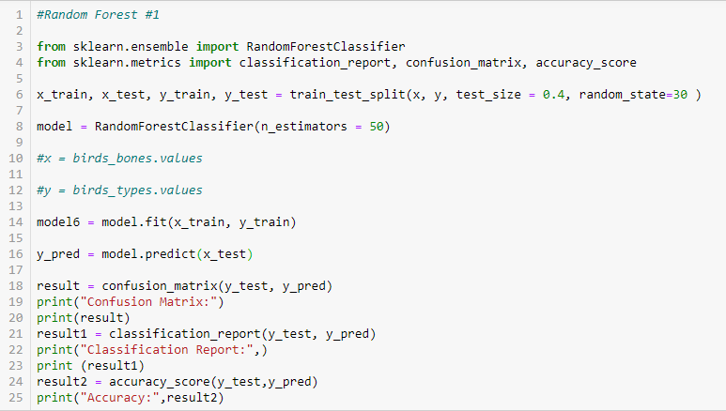
First random forest

Slide 19
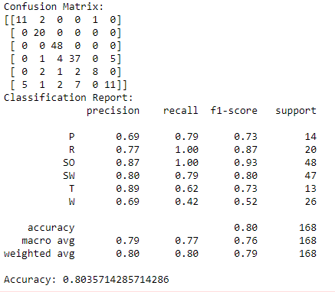
First random forest - results

Slide 20
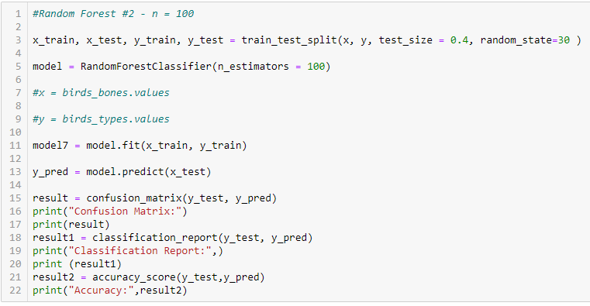
Second random forest

Slide 21
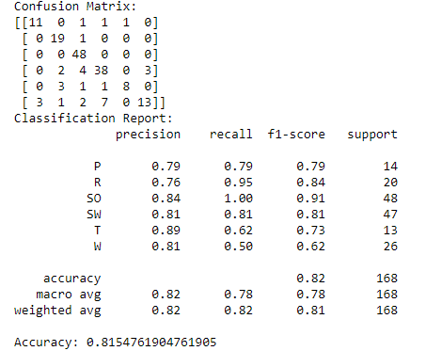
Second random forest - results

Slide 22
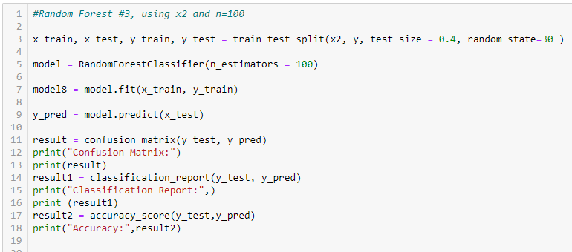
Third random forest

Slide 23
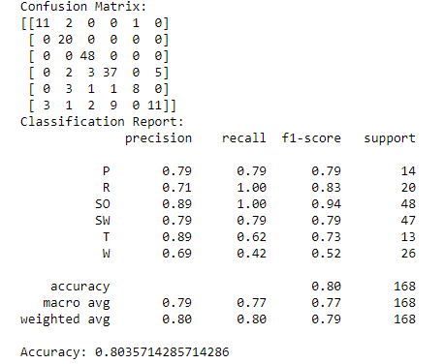
Third random forest - results

Slide 24
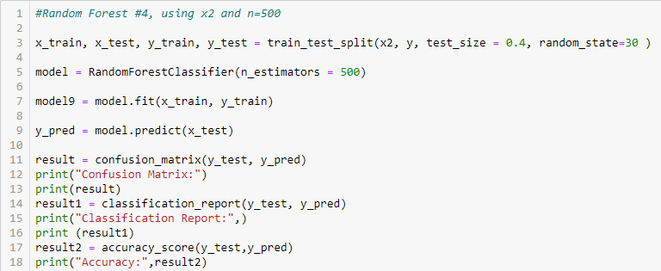
Fourth random forest

Slide 25
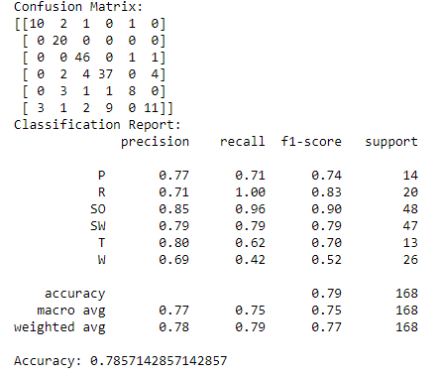
Fourth random forest - results

Slide 26
Conclusion
Second random forest algorithm is the one I will use because it is the most powerful, includes the most amount of data and gives one of the best results.
More data collection is needed to improve the efficacy of my machine learning algorithm.

